Slide 1
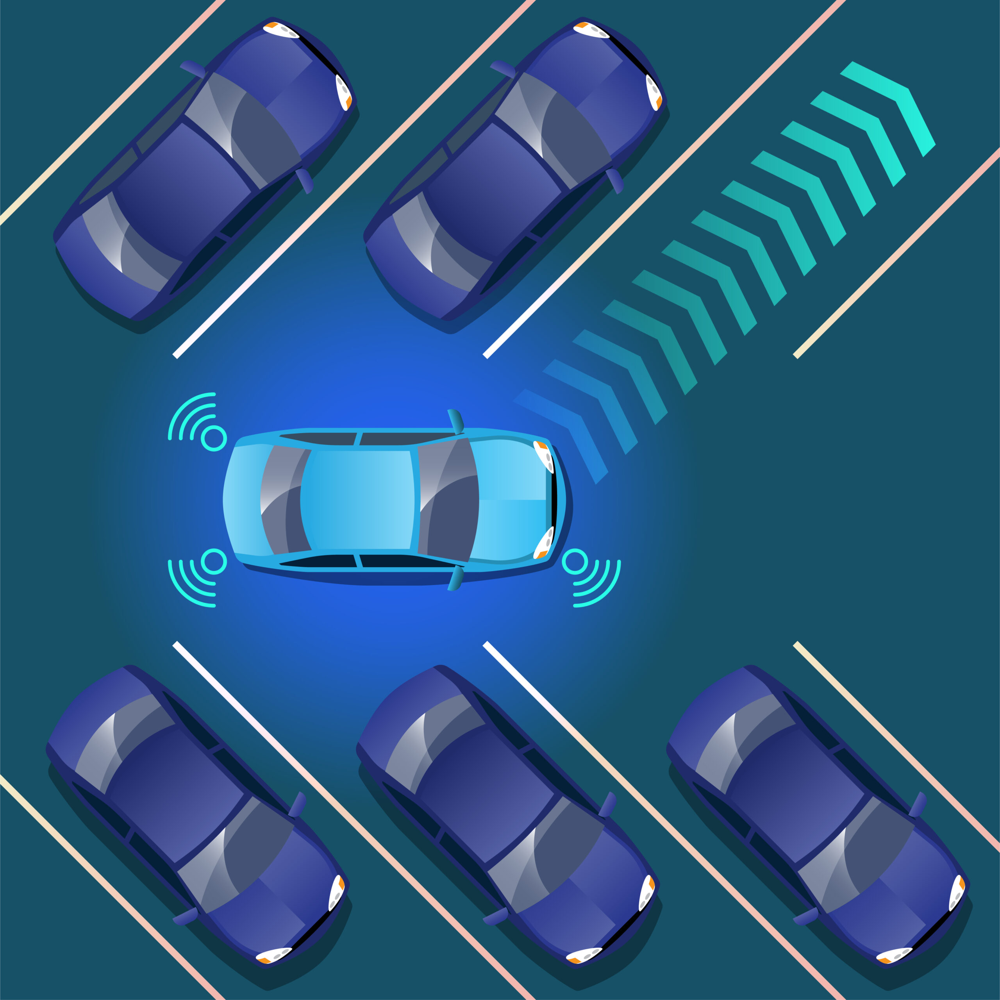
VEHICLE PARKING MANAGEMENT SYSTEM

Slide 2
WHAT IS PARKING MANAGEMENT SYSTEM
Automated system to monitor and control parking spaces
Manages vehicle entry, tracking, and exit efficiently
Supports real-time space availability information
Integrates sensors, cameras, and payment systems
Provides analytics and operational insights

Slide 3
USES And BENIFITS
Reduce parking search time by 30% - drivers find spaces quickly
Optimize space utilization - prevent wasted slots and congestion
Automate payment collection - support multiple payment methods
Monitor and enforce rules - detect violations and overstay vehicles
Improve security - surveillance and access control for safety

Slide 4
Uses Across Different Sectors
Commercial
Malls, airports, shopping centers - maximize revenue
Institutional
Colleges, hospitals, offices - manage space allocation
Urban
City parking - reduce traffic and emissions

Slide 5
System Architecture
Hardware
Sensors, cameras, barriers, payment kiosks
Software
Management platform, real-time tracking
Cloud
Data storage, analytics, reporting

Slide 6
System Workflow
Main Loop:
Display Menu
Get User Choice
Execute Function
Repeat until Exit Selected

Slide 7
Key Hardware Components
IoT Sensors - Detect occupied/vacant spaces
License Plate Recognition (LPR) Cameras
Entry/Exit Barriers - Control vehicle access
Payment Kiosks - Support multiple payment methods
RFID Readers - For automated access

Slide 8
Sensor System
Real-time detection of vehicle presence
Monitors parking space availability
Transmits data to central system
LiDAR and ultrasonic sensors for accuracy
Enables dynamic space allocation

Slide 9
Central Control System
Core brain of the parking system
Processes real-time sensor data
Manages user accounts and payments
Generates reports and analytics
Enables remote system monitoring

Slide 10
Conclusion
VPMS is essential for modern urban parking management and traffic control
Improves user experience with real-time space availability and quick navigation
Enables efficient space utilization, revenue generation, and operational automation
Supports sustainability goals by reducing fuel consumption and vehicle emissions
Foundation for smart cities integrating IoT, AI, and intelligent transportation systems

Slide 11

THANK YOU
Presente by:
K.Haneesha
K.Ganga bhavani
g.Chaithanya
G.Shri Akhilesh

